Slide 1
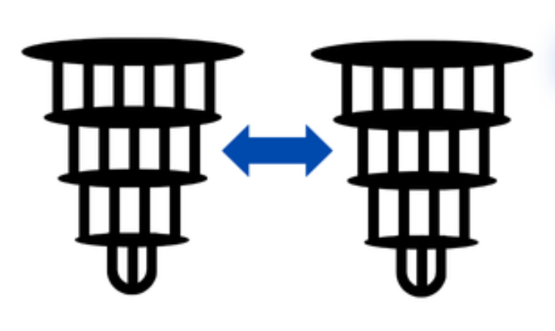
Distributing Quantum Computing,
The next frontier
An introduction to the theoretical aspects behind distributed quantum computing, with a focus on its fundaments, challenges & opportunities for the future of quantum computing.
María Gragera Garcés

Slide 2
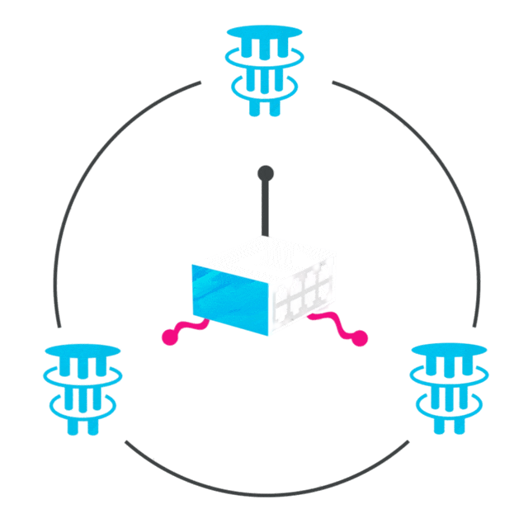
Why distribute quantum computing?
Quantum computers have a limited number of qubits.
To continuously grow the size of these devices is a technically challenging and costly goal.
Distribution aims to interconnect various devices to cooperate to solve a joint operation.
This would enable to scale quantum computing modularly, reusing existing hardware, and getting close to useful quatum compute.

Slide 3

What does it mean to
distribute qc?
Paradigm where multiple quantum computer are connected and cooperate to execute a joint program.
Each node mantains its own set of local qubits and communicated with other devices through quantum channels.
Contrary to the distribution of classical compute, the communication between devices must maintain entanglement and the coherence of the quantum computation.

Slide 4
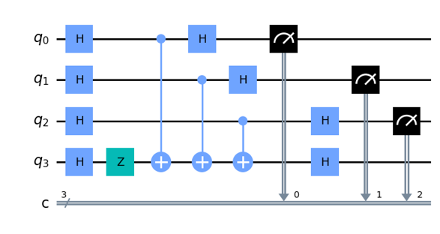


Distributed operations
Teleportation
(Wire cutting / Teledata)
Non-local operatio s
(Gate cutting / Telegate)

Slide 5
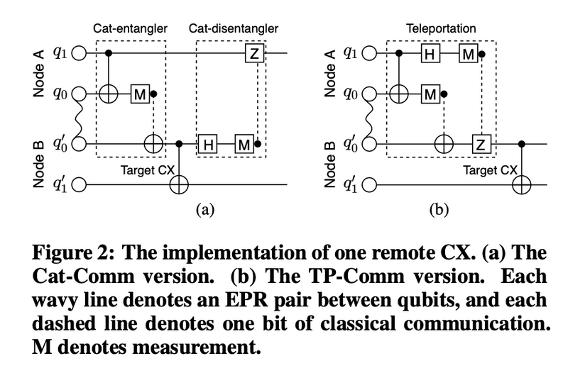
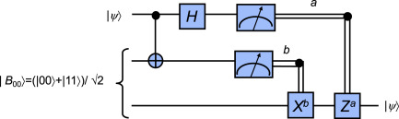
Communication primitives
Teleportation
(Wire cutting / Teledata)
Non-local operatio s
(Gate cutting / Telegate)

Slide 6
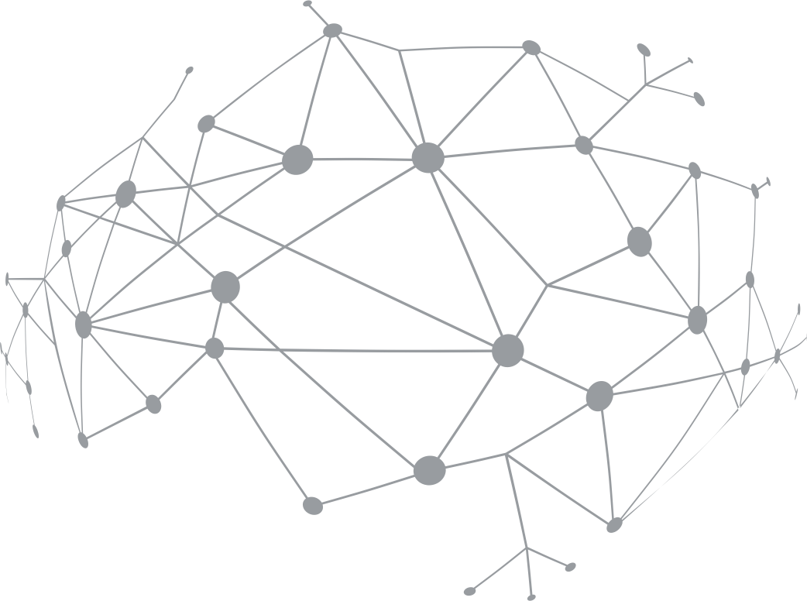
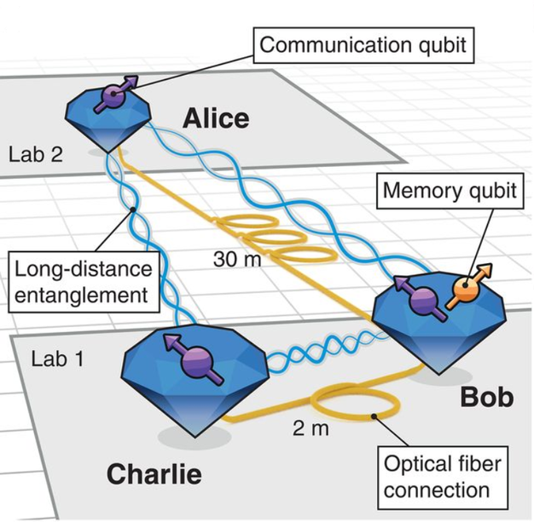
Quantum networks
The goal of a quantum network (in the context of DQC) is to distribute entanglements amongst nodes, enabling tasks such as:
Quantum teleportations amongst QPUs.
Synchronization and quantum secure communication through quantum keys.
Distributed quantum computation, where various nodes collaborate to complete a joint task

Slide 7
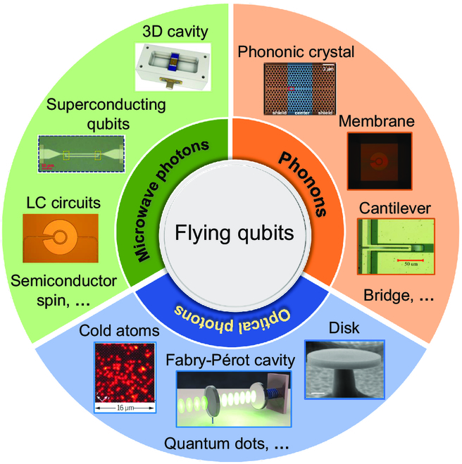
Flying qubits

Slide 8
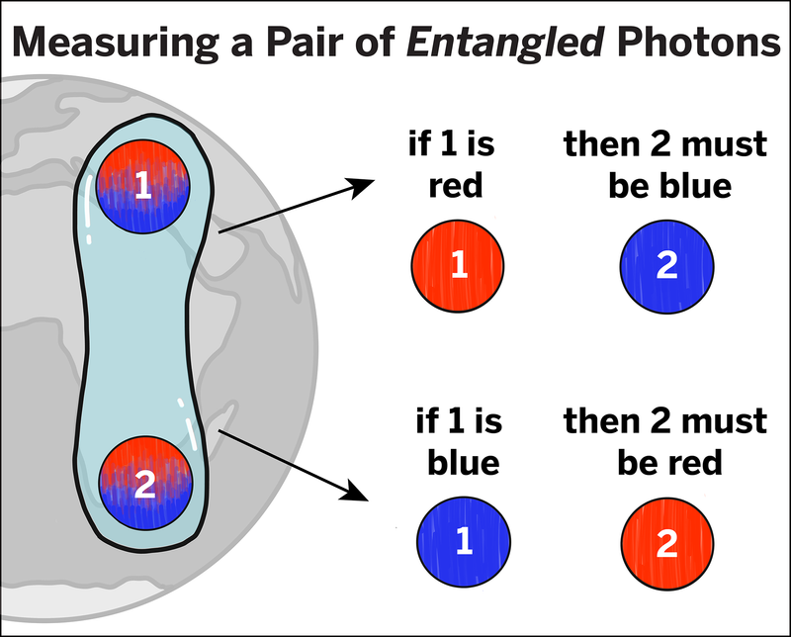
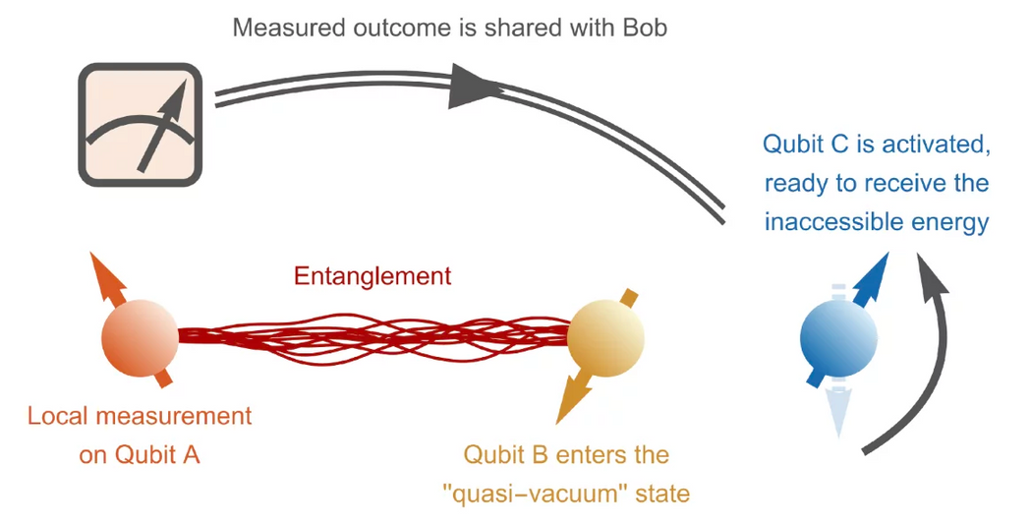
Quantum teleportation
Quantum teleportation allows the transfer of a qubit’s quantum state from one particle to another without physically moving the qubit. It works through entanglement between two shared particles and a classical communication channel that carries the results of a measurement.
The process requires three key elements:
Shared entanglement between the sender (Alice) and the receiver (Bob).
A joint measurement on the original qubit and Alice’s half of the entangled pair.
Classical communication so that Bob can apply a correction and reconstruct the original state.
In this way, quantum information is effectively “moved” without the particle itself traveling, preserving the coherence of the system.

Slide 9
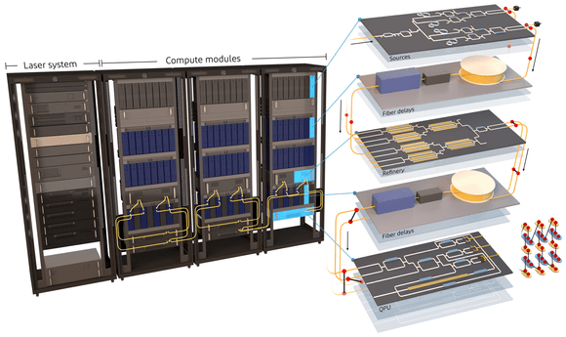
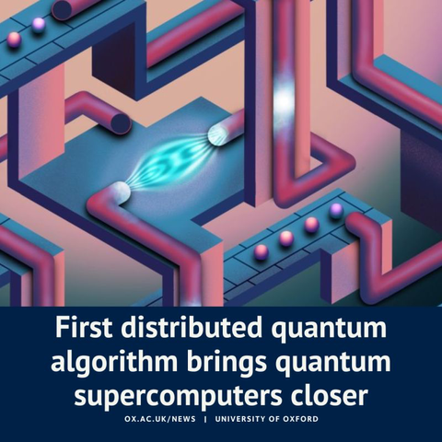
State of the art of DQC
Distributed Quantum Computing is a young field.
The first theoretical works appeared around 2018, and today we’re reaching the point of seeing experimental demonstrations of distribution.
A year ago Xanadu announced Aurora, the first distributed quantum computer (yet to be made publicly available).
A group at the University of Oxford achieve a teleportation amongst two nodes, a modest but significative step towards ”real” DQC.
In just seven year, the field has moved from theory to experimental demonstrations of quantum distribution.

Slide 10

State of the art of DQC
Distributed Quantum Computing is a young field.
The first theoretical works appeared around 2018, and today we’re reaching the point of seeing experimental demonstrations of distribution.
A year ago Xanadu announced Aurora, the first distributed quantum computer (yet to be made publicly available).
A group at the University of Oxford achieve a teleportation amongst two nodes, a modest but significative step towards ”real” DQC.
In just seven year, the field has moved from theory to experimental demonstrations of quantum distribution.
Accessible system that sustains a reasonable quantum computation in each node and is interconnected by a programmable quantum network.

Slide 11
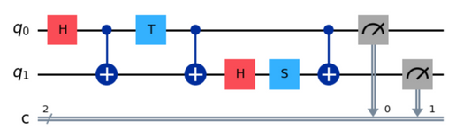
Scientific abstractions
The DQC mapping problem
Quantum workload
Circuit/ MBQC pattern/ Quantum walk/ Hybrid computation /...
Maria Gragera Garces, Chris Heunen, and Mahesh Marina. 2025. Distributed Quantum Computing Across Heterogeneous Hardware with Hybrid Dependency Hypergraphs. In Proceedings of the ACM SIGCOMM 2025 Posters and Demos (ACM SIGCOMM Posters and Demos '25). Association for Computing Machinery, New York, NY, USA, 49–51. https://doi.org/10.1145/3744969.3748417

Slide 12
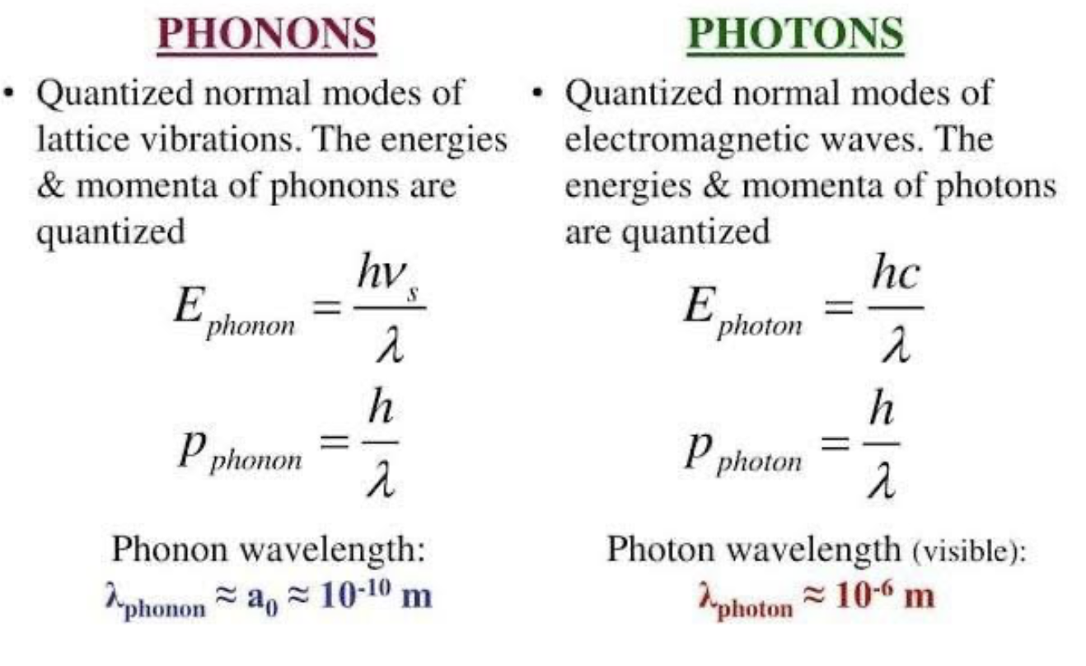
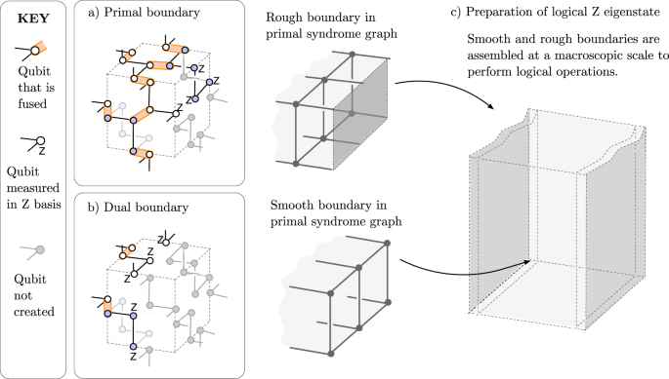
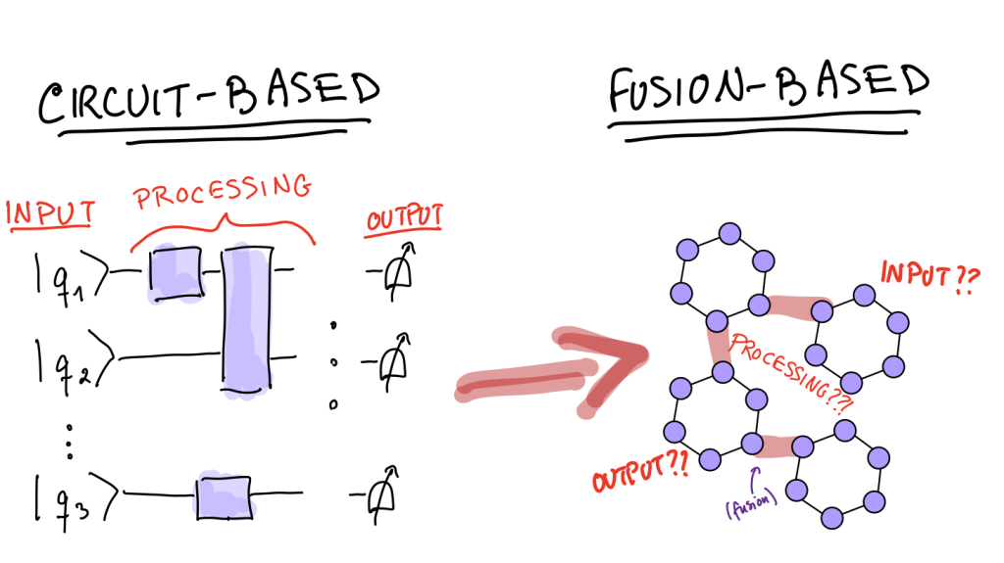
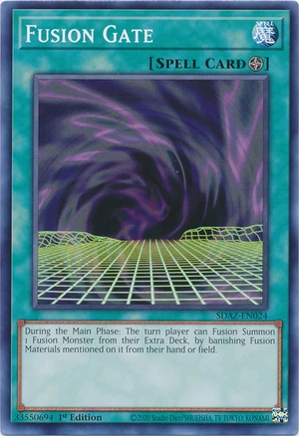
Pho(t/n)ons
Circuits
MBQC

Slide 13
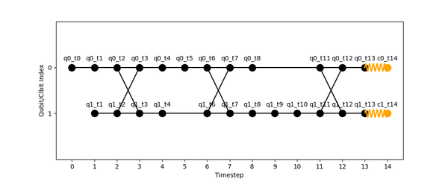
Scientific abstractions
The DQC mapping problem
Quantum workload
Intermediate abstraction
Circuit/ MBQC pattern/ Quantum walk/ Hybrid computation /...
A representation that captures the dependencies of data through the computation.
Hypergraph abstraction
Maria Gragera Garces, Chris Heunen, and Mahesh Marina. 2025. Distributed Quantum Computing Across Heterogeneous Hardware with Hybrid Dependency Hypergraphs. In Proceedings of the ACM SIGCOMM 2025 Posters and Demos (ACM SIGCOMM Posters and Demos '25). Association for Computing Machinery, New York, NY, USA, 49–51. https://doi.org/10.1145/3744969.3748417

Slide 14
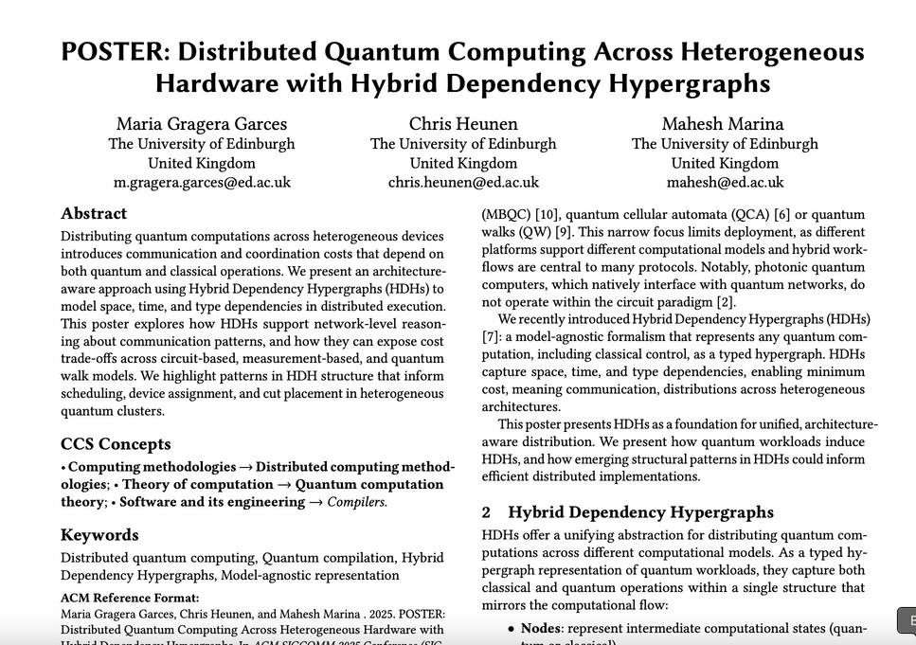
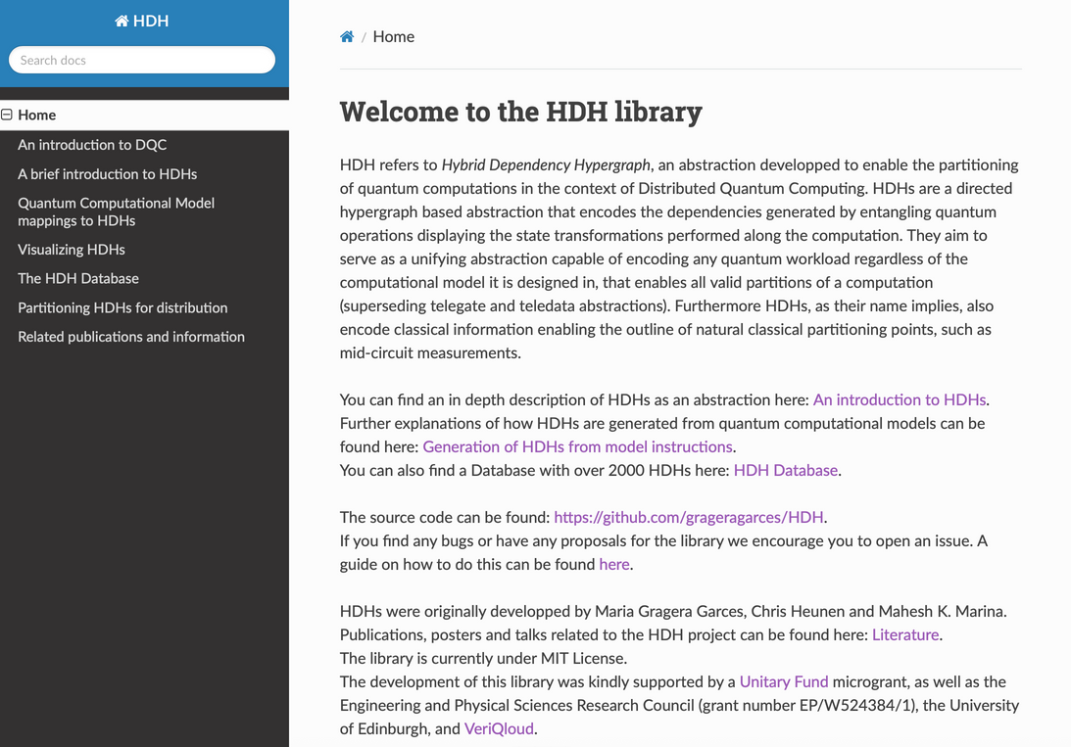
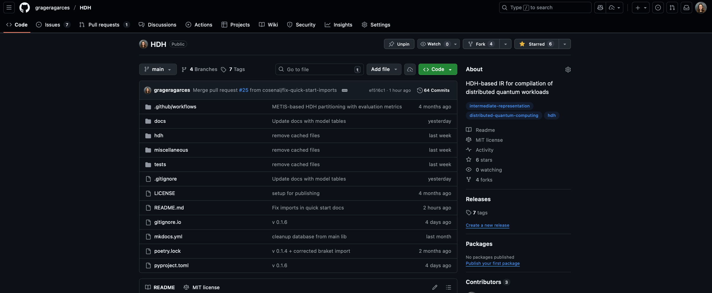
HDHs

Slide 15
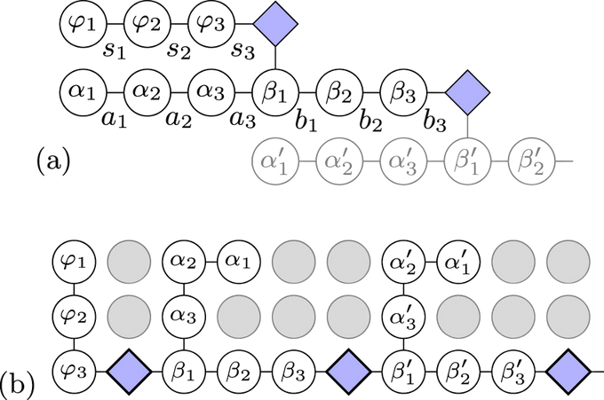
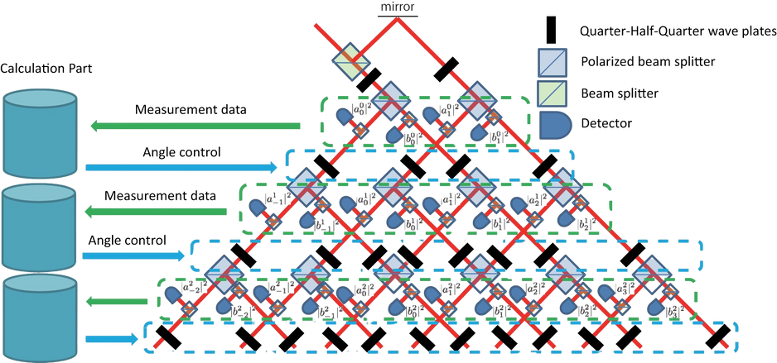
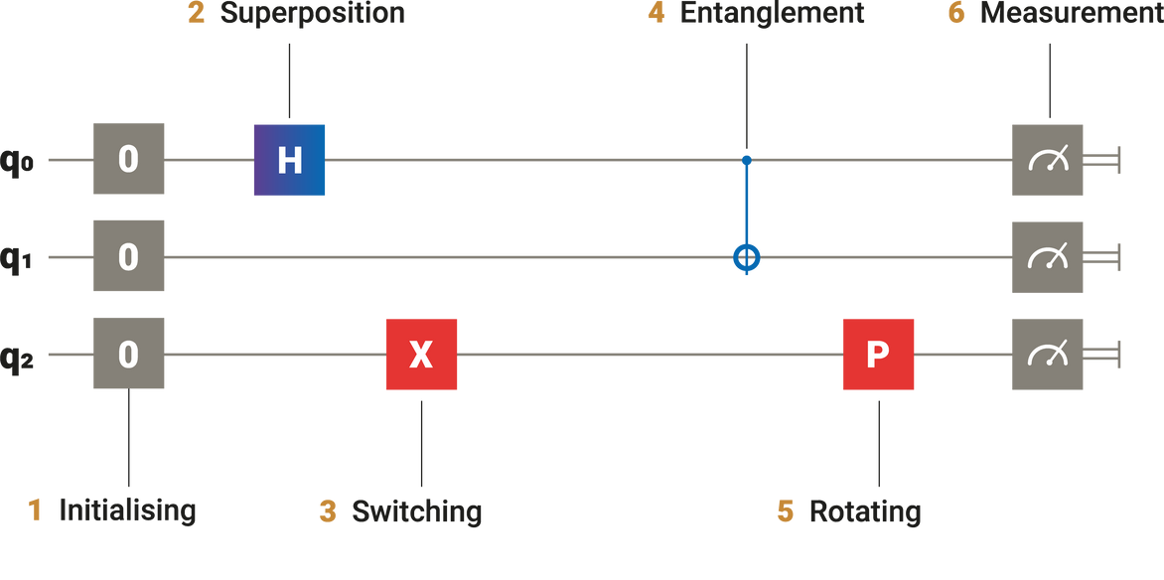
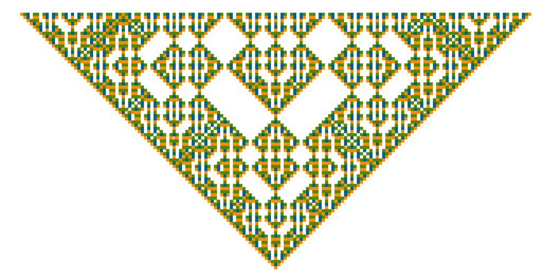
HDHs
Quantum workload
There exist multiple models of QC
Circuit/ MBQC pattern/ Quantum walk/ Hybrid computation /...
Circuits
MBQC Patterns
Quantum walks
Quantum cellular automata

Slide 16
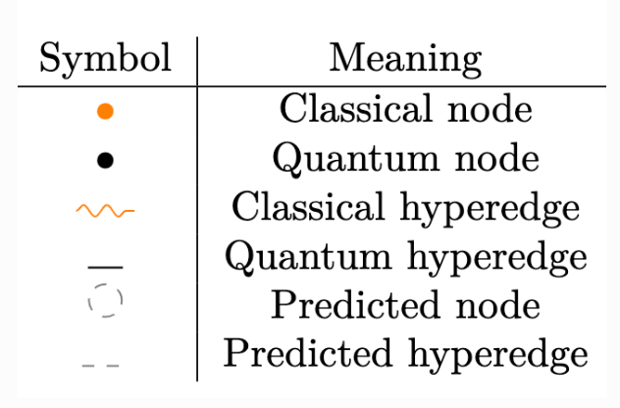
HDHs
Intermediate abstraction
A representation that captures the dependencies amongst data through the computation.
The goal is to represent computation such that we can evaluate the minimum cost of its distribution.

Slide 17
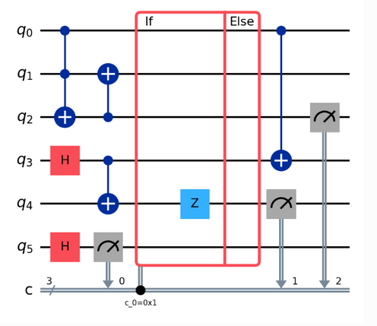
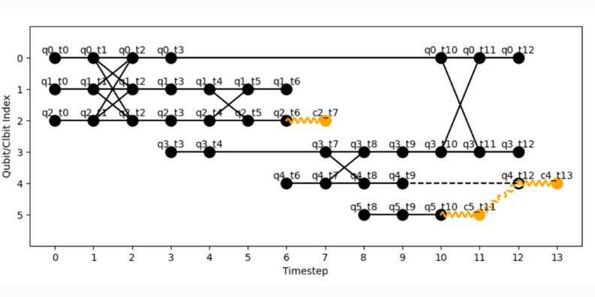
HDHs
Quantum workload
Intermediate abstraction
Circuit/ MBQC pattern/ Quantum walk/ Hybrid computation /...
A representation that captures the dependencies amongst data through the computation.

Slide 18
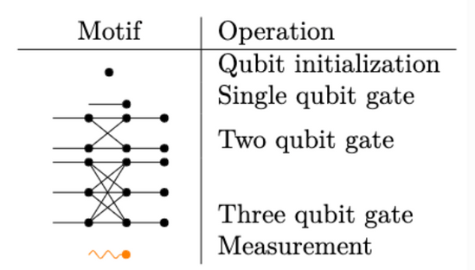
HDHs
Quantum workload
Intermediate abstraction
Circuit/ MBQC pattern/ Quantum walk/ Hybrid computation /...
A representation that captures the dependencies amongst data through the computation.

Slide 19
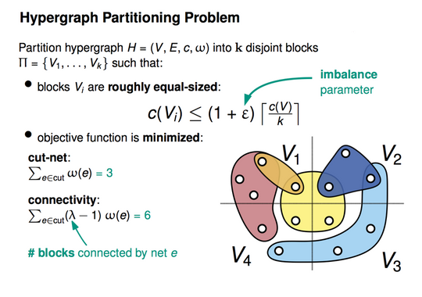


Scientific abstractions
The DQC mapping problem
Quantum workload
Intermediate abstraction
Partitioning
Circuit/ MBQC pattern/ Quantum walk/ Hybrid computation /...
A representation that captures the dependencies of data through the computation.
The representation is divided into smaller chunks of work that can be completed either sequentially or in parallel in a network of quantum and classical devices.
Hypergraph abstraction
kahypar.org
Maria Gragera Garces, Chris Heunen, and Mahesh Marina. 2025. Distributed Quantum Computing Across Heterogeneous Hardware with Hybrid Dependency Hypergraphs. In Proceedings of the ACM SIGCOMM 2025 Posters and Demos (ACM SIGCOMM Posters and Demos '25). Association for Computing Machinery, New York, NY, USA, 49–51. https://doi.org/10.1145/3744969.3748417

Slide 20
Scientific abstractions
KaHyPar
Fiduccia–Mattheyses

Slide 21
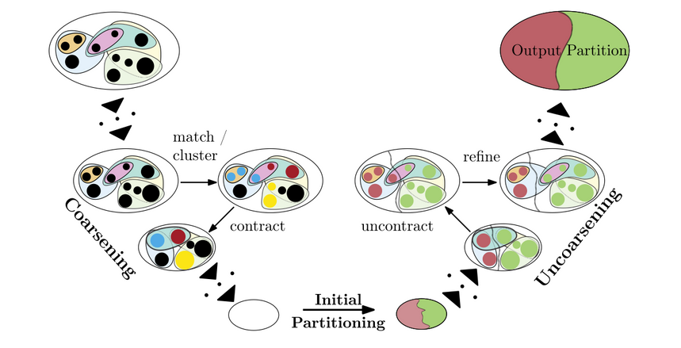
Scientific abstractions
KaHyPar
Fiduccia–Mattheyses
Coarsening: Nodes are iteratively merged into supernodes based on similarity heuristics, such as heavy-edge matching, reducing the problem size while attempting to preserve the essential cut structure.
Initial partitioning: The reduced hypergraph is partitioned using a submethod (often a greedy partitioning or the FM algorithm), under the assumption that a good cut in the reduced hypergraph will also be good in the original one.
Uncoarsening and refinement: The hypergraph is gradually expanded back to its original size, applying local improvement heuristics at each stage to reassign boundary nodes and further reduce the cut size
Scalable High-Quality Hypergraph Partitioning
GeirguaTech FM notes

Slide 22
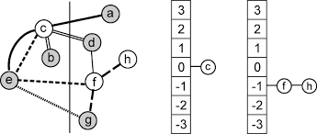
Scientific abstractions
KaHyPar
Fiduccia–Mattheyses
Coarsening: Nodes are iteratively merged into supernodes based on similarity heuristics, such as heavy-edge matching, reducing the problem size while attempting to preserve the essential cut structure.
Initial partitioning: The reduced hypergraph is partitioned using a submethod (often a greedy partitioning or the FM algorithm), under the assumption that a good cut in the reduced hypergraph will also be good in the original one.
Uncoarsening and refinement: The hypergraph is gradually expanded back to its original size, applying local improvement heuristics at each stage to reassign boundary nodes and further reduce the cut size
Gain computation: For each node v, its gain is calculated.
Node selection: The node with the highest gain that can be moved without violating the balance constraint is selected.
Move and lock: The selected node is moved to the other partition and locked so it cannot be moved again during the current pass.
Neighbor update: The gains of neighboring nodes are recalculated to reflect the new partition structure.
Iteration: Node movements are repeated until no further beneficial moves are possible under the balance constraint.
Scalable High-Quality Hypergraph Partitioning
GeirguaTech FM notes

Slide 23

Scientific abstractions
The DQC mapping problem
Quantum workload
Intermediate abstraction
Partitioning
Mapping to a hybrid network
Circuit/ MBQC pattern/ Quantum walk/ Hybrid computation /...
A representation that captures the dependencies of data through the computation.
The representation is divided into smaller chunks of work that can be completed either sequentially or in parallel in a network of quantum and classical devices.
The sub-workloads are assigned to nodes of a network made up of both quantum and classical devices, which are set to collaborate. Depending on the type of available channels (classical or quantum), you can use communication primitives to connect the partitions.
What network?
Hypergraph abstraction
kahypar.org
Maria Gragera Garces, Chris Heunen, and Mahesh Marina. 2025. Distributed Quantum Computing Across Heterogeneous Hardware with Hybrid Dependency Hypergraphs. In Proceedings of the ACM SIGCOMM 2025 Posters and Demos (ACM SIGCOMM Posters and Demos '25). Association for Computing Machinery, New York, NY, USA, 49–51. https://doi.org/10.1145/3744969.3748417

Slide 24
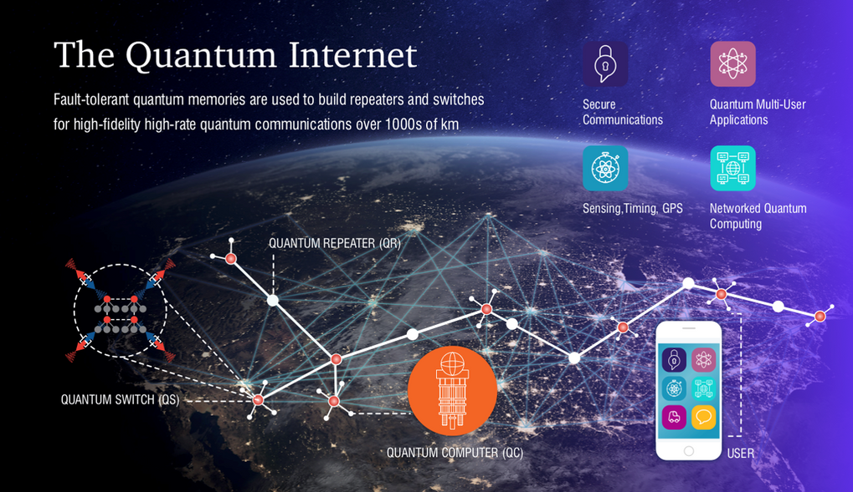
Quantum internet
The Quantum Internet is a global network that will connect quantum devices (computers, sensors, and repeaters) through links that distribute entanglement. Its goal is not to transmit classical bits, but entangled qubits, preserving quantum correlations over long distances.
Unlike the classical Internet, this network is expected to enable:
Quantum secure communication through QKD.
Distributed quantum computing between remote processors.
Ultraprecise synchronization and new types of global sensors.
Building it requires hybrid infrastructure: optical channels, quantum repeaters, and coordinated classical control. It will serve as the foundation connecting the nodes of the future quantum ecosystem.

Slide 25
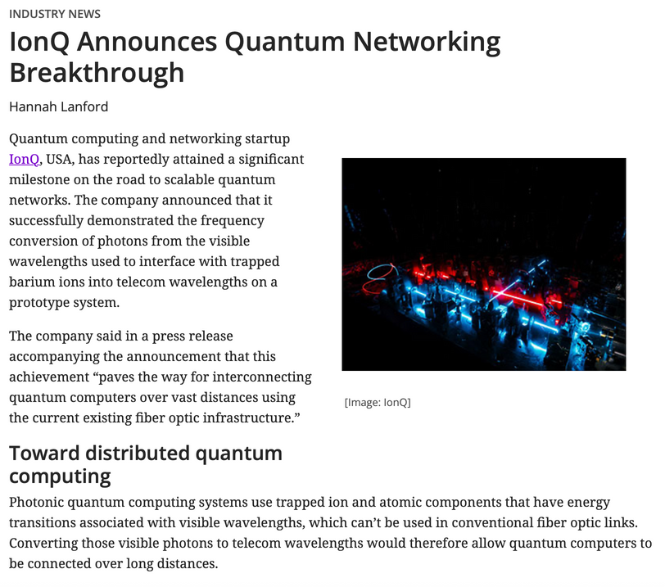
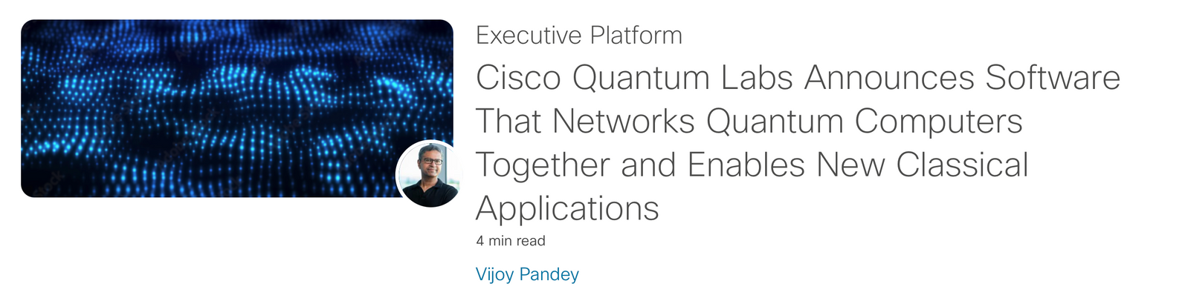
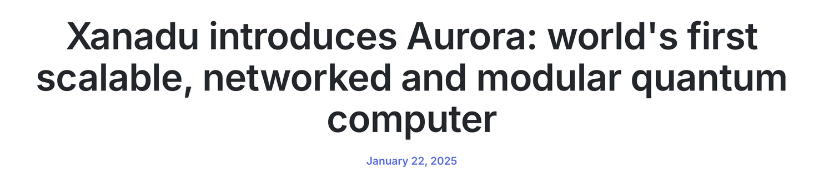
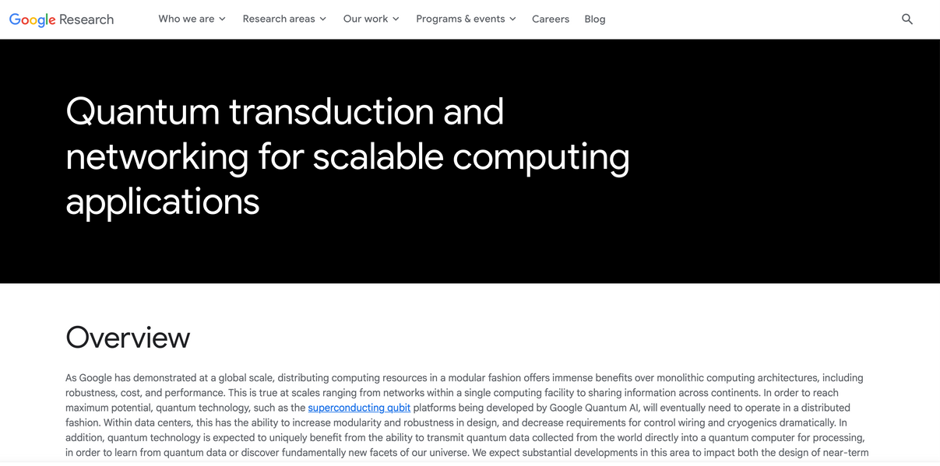
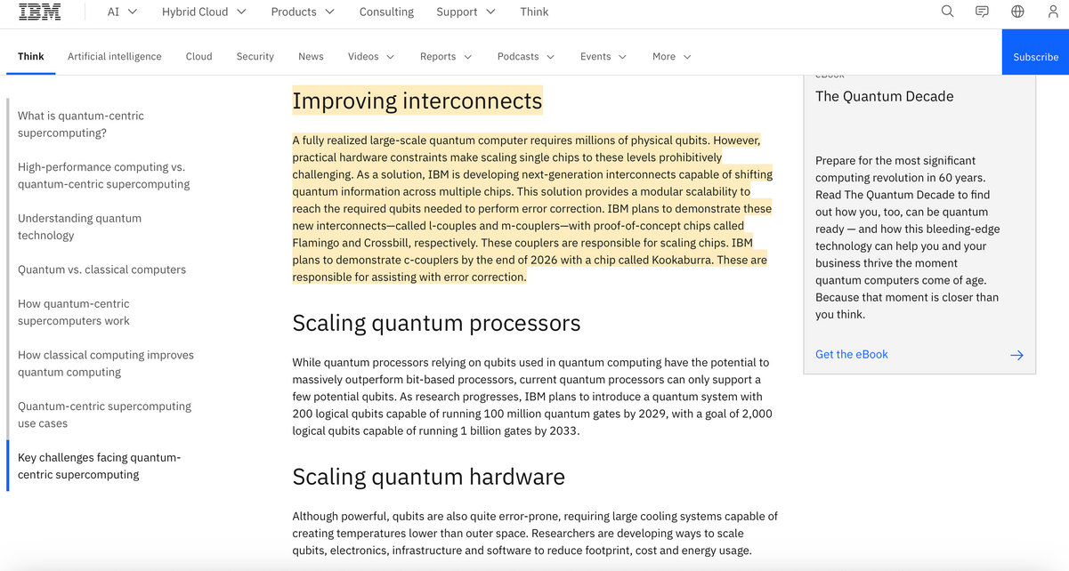
Today’s actors

Slide 26
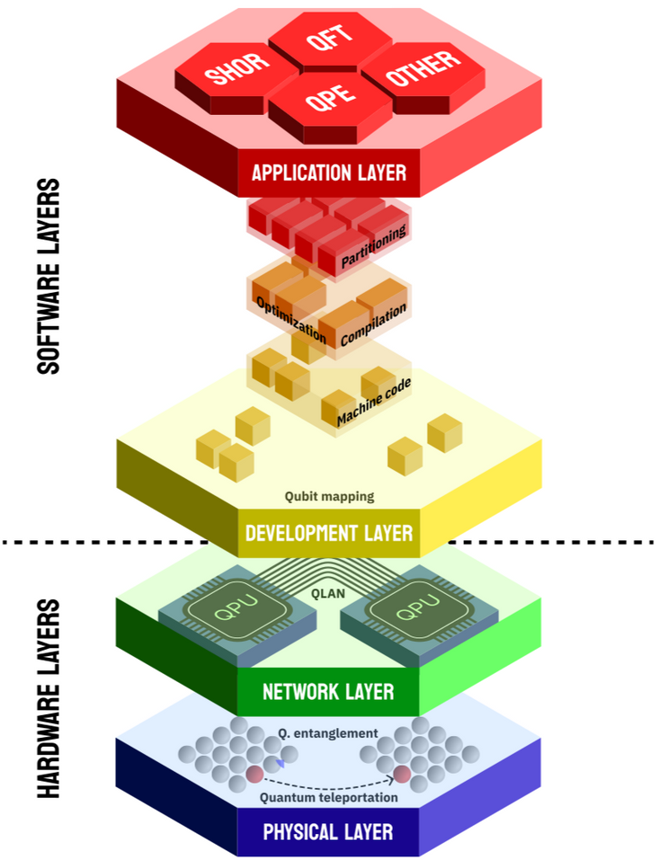
Loads to build

Slide 27
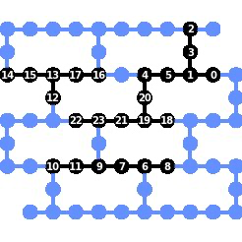

Loads to build

